Slide 1

Data Structures and Algorithms
Notes, Single Source Shortest Path

Slide 2
Shortest Path Problems
There are a variety of different shortest path problems.
Shortest Path from given node S to given goal node G
Lowest-cost-first search
A* search

Slide 3
Shortest Path Problems
Shortest path tree from given node S to every other node in (connected) graph (this week)
Directed Acyclic Graph
DAG-Shortest-Path algorithm
All path lengths non-negative
Dijkstra’s/Lowest-Cost-First algorithm
Some path lengths negative
Bellman-Ford Algorithm

Slide 4
Shortest Path Problems
Shortest paths from every node to every other node
“Folklore” Algorithm (highly intuitive)
Floyd-Warshall Algorithm (best for dense graphs)
Johnson’s Algorithm (best for sparse graphs)

Slide 5
General Idea: Initialization
Initialize the problem: O(V)
v.d means the distance from source s to v.
v.π means the predecessor node along the path from s to v with distance v.d.
W(u,v) is the distance [weight] of the edge from u to v
Initialize-Single-Source (G,s)
for each node v ∈ G.V
v.d = ∞
v.π = ∅
s.d = 0

Slide 6
General Idea: Relaxation
For some node v, find a node u such that the distance to node v from the source via edge uv is shorter than any seen so far.
Bellman-Ford tries to relax each edge |V|-1 times
Dijkstra’s algorithm/LCFS relaxes each edge once.
A* search relaxes each edge once.
What’s the asymptotic running time of this?
Relax(u,v,w)
if v.d > u.d + w(u,v)
v.d = u.d + w(u,v)
v.π = u

Slide 7
General Idea: Correctness Assumptions (I)
We won’t bother to prove correctness of these algorithms (see Sec. 24.5 of CLRS if interested) but we rely on the truth of various properties.
Notation:
δ(s,a) is the minimum distance from s to a

Slide 8
General Idea: Correctness Assumptions (II)
Triangle Inequality: For any vertices u,v with an edge (u,v), δ(s,v) ≤ δ(s,u) + w(u,v)
Upper bound property: v.d ≥ δ(s,v), and v.d only decreases as the algorithm proceeds.
No-path property: If there’s no path from s → v, δ(s,v) = ∞
Convergence property: If the shortest path from s to v ends with edge (u,v), then once we’ve found δ(s,u) and relaxed edge (u,v), we’ve found δ(s,v).
Path-relaxation property: If the shortest path s → v_{k} is s→v₀→v₁→…→v_{k}, and if we relax the edges in order (s,v₀), (v₀,v₁), …, (v_{k-1},v_{k}), then v_{k}.d = δ(s,v).
Predecessor-subgraph property: After finding all shortest paths, the predecessor subgraph is a shortest path tree rooted at s.

Slide 9
Bellman-Ford Algorithm
Most general algorithm.
Works for any connected graph.
Finds negative-cost cycles if they exist.
Determine an order in which to work through the edges.
Probably best to start with edges from the start node, but you don’t have to.
Relax each edge in this same order |V|-1 times.
Then check to see if relaxing each edge once more will lower the distance to any node.
If so, the graph has a negative weight cycle.
If not, you have the shortest-path graph.

Slide 10
Bellman-Ford Pseudocode
boolean Bellman-Ford(G,w,s)
initialize-single-source (G,s)
for i = 1 to |G.v|-1
for each edge (u,v) ∈ G.E
Relax(u,v,w)
for each edge (u,v) ∈ G.E
if v.d > u.d + w(u,v)
return False //neg wt cyc
return True

Slide 11
Bellman-Ford Pseudocode
boolean Bellman-Ford(G,w,s)
initialize-single-source (G,s)
for i = 1 to |G.v|-1
for each edge (u,v) ∈ G.E
Relax(u,v,w)
for each edge (u,v) ∈ G.E
if v.d > u.d + w(u,v)
return False // cycle
return True
Initialization is O(V)
Relaxes O(VE) times
Each relaxation is O(1)
Running time is O(V) + ( O(VE) * O(1) ) +O(E)= O(VE)

Slide 12
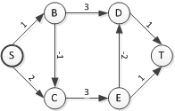
Bellman-Ford Example
For example, here is the graph from the quiz.
Assume we process edges in alphabetical order by start node of edge then by finishing node of edge.
Treat “S” as if it were labeled “A”.
Treat “T” as if it were labeled “F”.

Slide 13
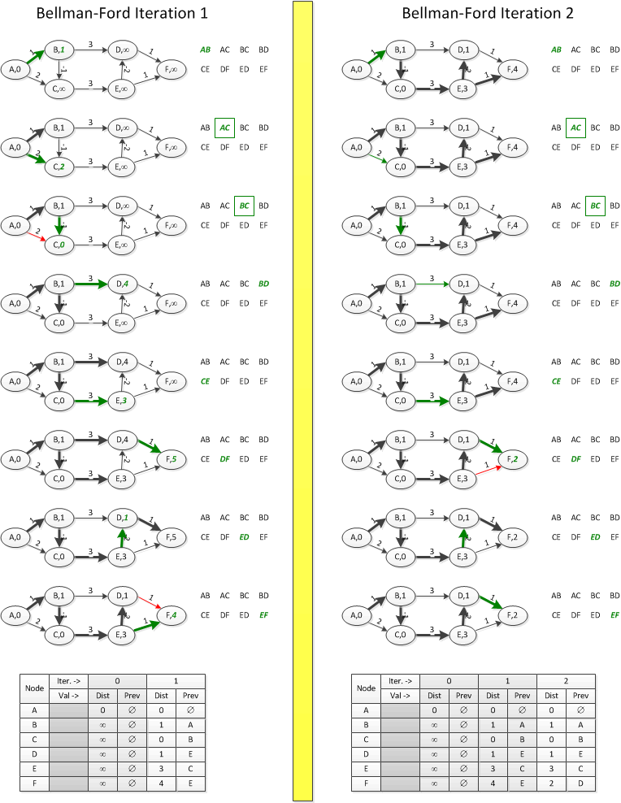
Bellman-Ford: 1st two iterations
Edge
Edge on lowest cost tree
New edge on lowest cost tree
Edge removed from lowest cost tree

Slide 14
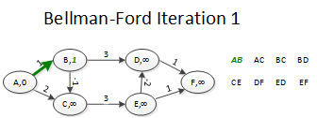
Bellman Ford, Iteration 1-1

Slide 15
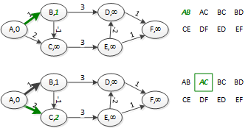
Bellman Ford, Iteration 1-2

Slide 16
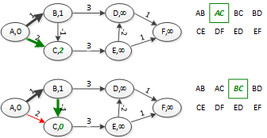
Bellman Ford, Iteration 1-3

Slide 17
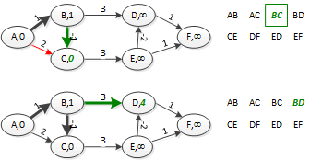
Bellman Ford, Iteration 1-4

Slide 18
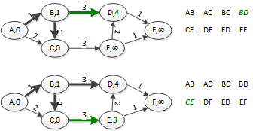
Bellman Ford, Iteration 1-5

Slide 19
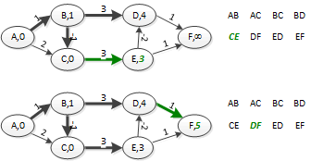
Bellman Ford, Iteration 1-6

Slide 20
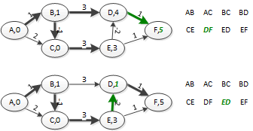
Bellman Ford, Iteration 1-7

Slide 21
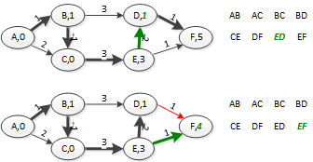
Bellman Ford, Iteration 1-8

Slide 22
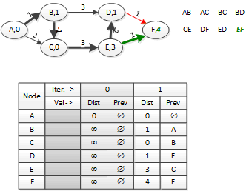
Bellman Ford, Iteration 1 end

Slide 23
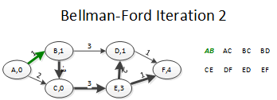
Bellman Ford, Iteration 2-1

Slide 24
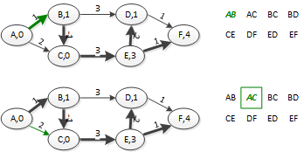
Bellman Ford, Iteration 2-2

Slide 25
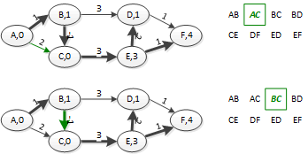
Bellman Ford, Iteration 2-3

Slide 26
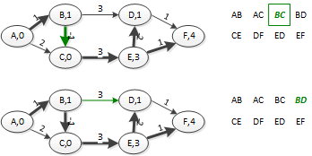
Bellman Ford, Iteration 2-4

